Slide 1
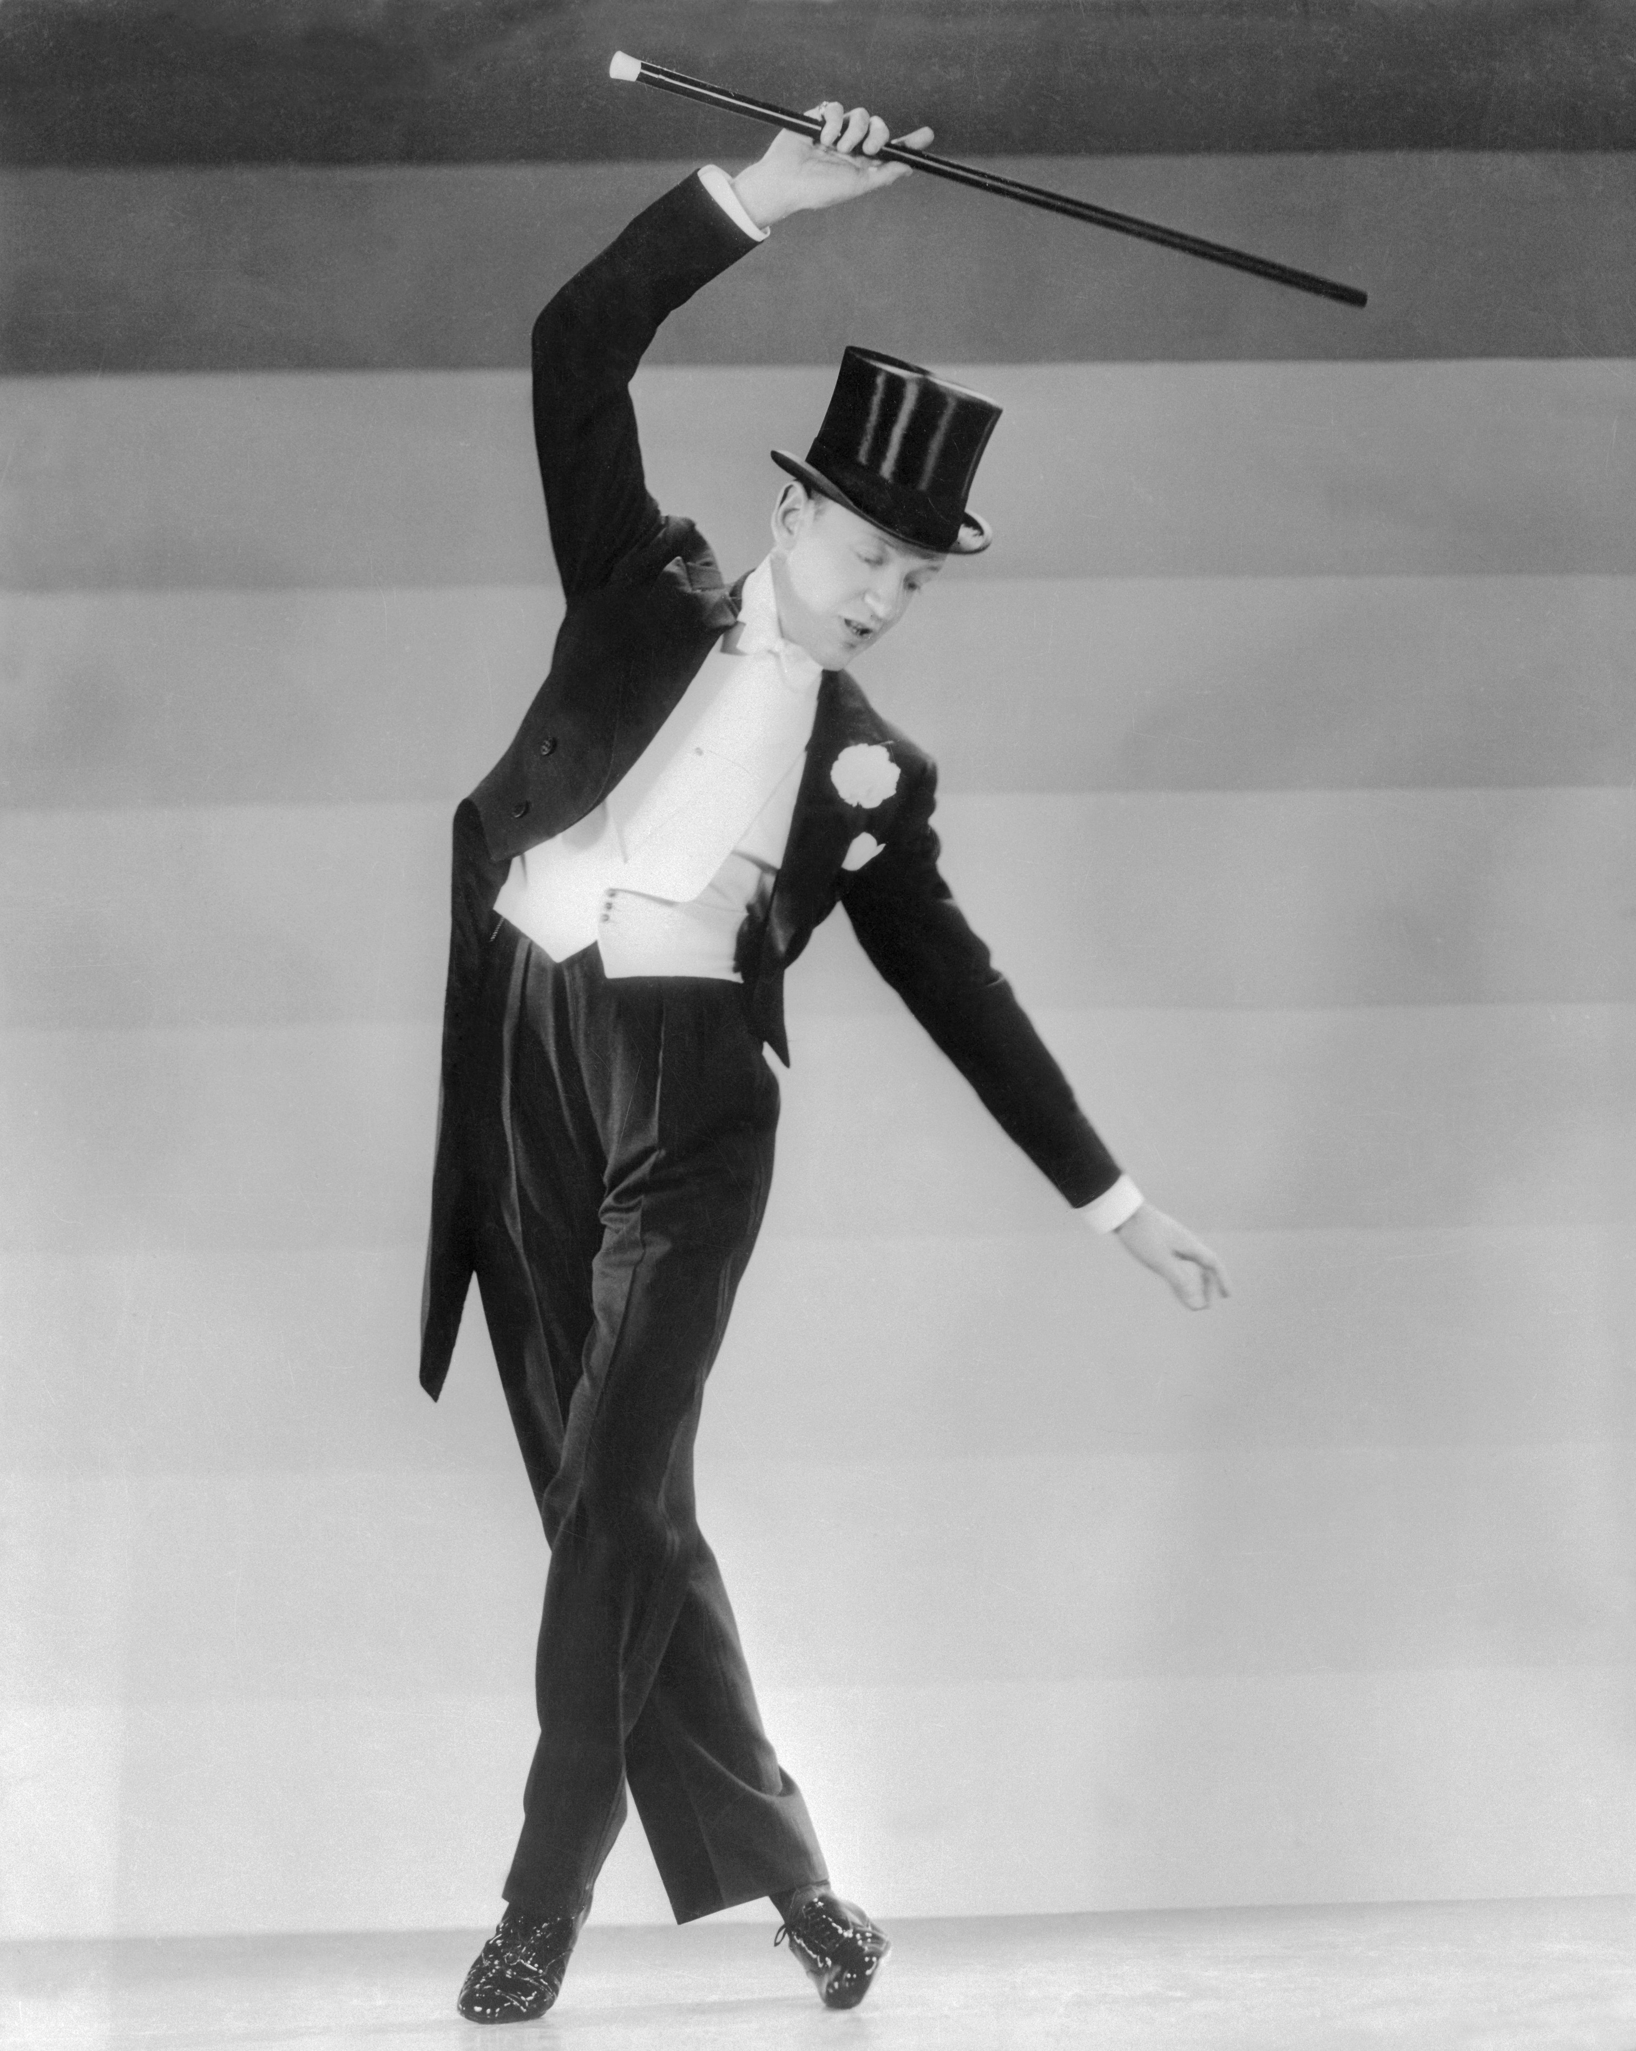
HAT CHAT: Networking 1
June 6th, 2021
John Wierzchowski
Notes:
Title & Introduce the CTF developers

Slide 2
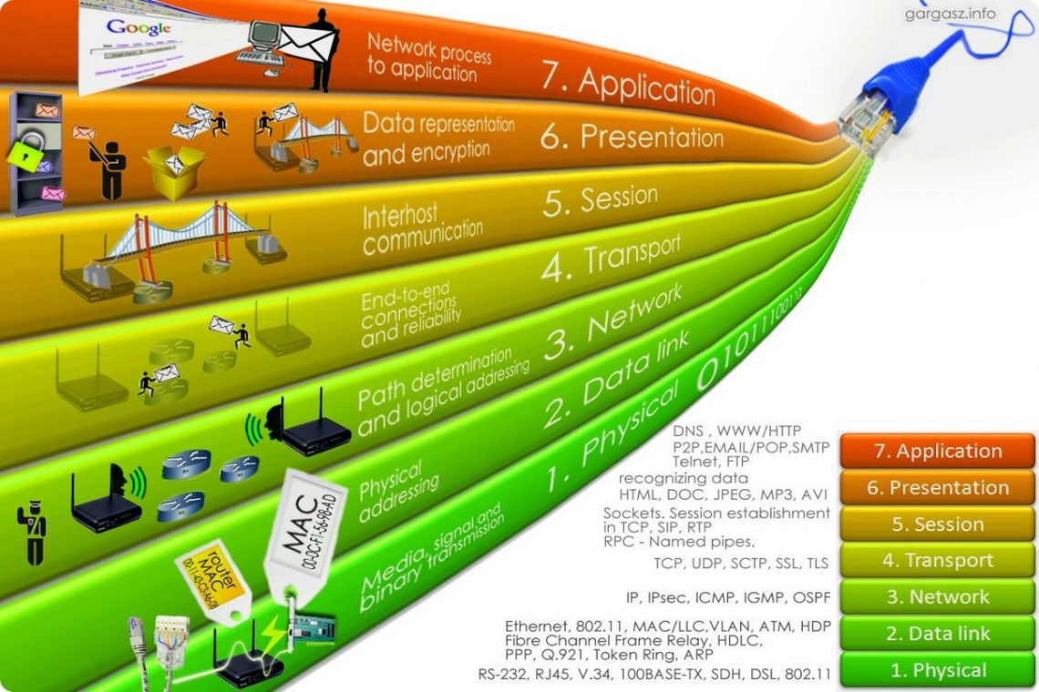

OSI Model
Notes:
Established in 1947, the International Organization for Standardization (ISO) was formed to bring together the standards bodies from countries around the world. Their definition of the model for Open Systems Interconnection, or OSI, is used to define modes of interconnection between different components in a networking system. This means that the physical method of transport can be designed independently of the protocols and applications running over it. For example, TCP/IP can be run over both Ethernet and FDDI networks, and Novell’s IPX and Apple’s AppleTalk protocols can both be run over Token Ring networks. These are examples of having independence between the physical network type and the upper layer protocols running across them. Consider also, two TCP/IP-enabled end systems communicating across a multitude of different network types, such as Ethernet, Frame Relay, and ATM. When we talk about Layer 2 and Layer 3 networking, it is these layers that we’re referring to, and logically the further up the OSI model we move, the greater intelligence we can use in networking decisions. Each layer plays its part in moving data from one device to another across a network infrastructure by providing a standard interface to the surrounding layers.

Slide 3
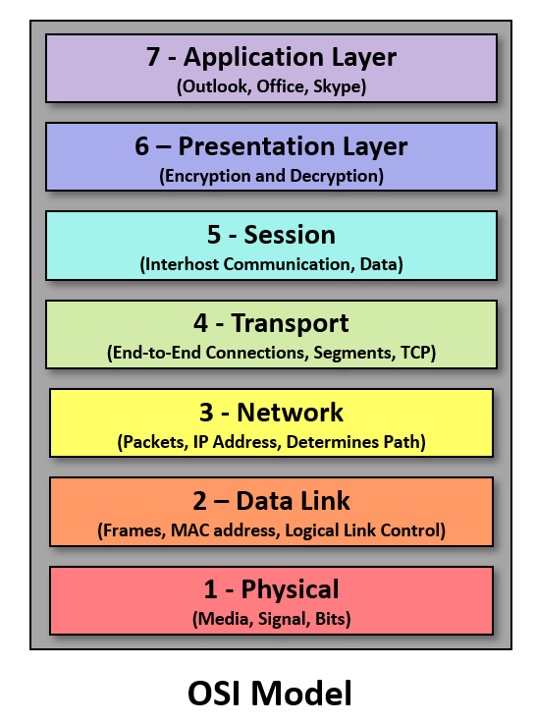
OSI Model
Frames layer 2
Packets layer 3
Segments and Datagrams layer 4
Notes:
When referring to Ethernet transmission, the terms frame and packet are often used interchangeably. However, they are not one and the same. Frames are used to transmit information between two nodes on the same network using MAC address, and they are generated at Layer 2 of the OSI model. In contrast, Packets are generated at Layer 3 and are used for transmitting information between different networks.
If you’re not familiar with the Open Systems Interconnection (OSI) model, it is the7-layer framework that describes how a network functions. Starting at the top, Layer 7 is the Application layer, which is essentially what the user encounters (think chrome). Layer 6 is the Presentation layer where data is prepared for the network format (think encryption). Layer 5 is the Session layer where two nodes are set up to communicate with each other. Layer 4 is the Transport layer that coordinates the transmission of data and determines the data rate and ensure error-free transmission. Layer 3 is the Network layer where packets are routed to various networks (across the internet). Layer 2 is the Data Link layer where information is sent from one device to another using MAC addresses and switching (think LAN). And last but not least is Layer 1, the Physical layer that includes the physical media needed for transmission (i.e., cable and radio frequency), and all its requirements, including pin layouts, voltages, performance parameters and more.
A data unit at layer 2, the data link layer, is a frame.
packet strictly refers to a protocol data unit at layer 3, the network layer
In layer 4, the transport layer, the data units are segments and datagrams.
Thus, TCP/IP communication over Ethernet, a TCP segment is carried in one or more IP packets, which are each carried in one or more Ethernet frames.

Slide 4
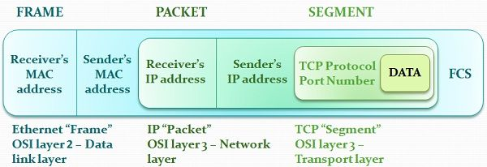
Ethernet Encapsulation
Notes:
In case you are wondering, Internet Protocol (IP) uses packets that are transmitted at Layer 3. Ethernet frames encapsulate IP packets by including additional information in the data field that includes IP addresses. Once that packet reaches its network switch, Layer 2 takes over and transmits frames based on the individual MAC address of the device. Think of it this way – An IP Address identifies a device on the Internet, which is why it is transmitted as a packet at Layer 3. MAC addresses identify the actual individual network card of a device and are transmitted as frames at Layer 2. Multiple devices that reside on the same network will not have MAC addresses that resemble each other in any way. MAC addresses are set by the manufacturer and never change (unless you spoof).

Slide 5
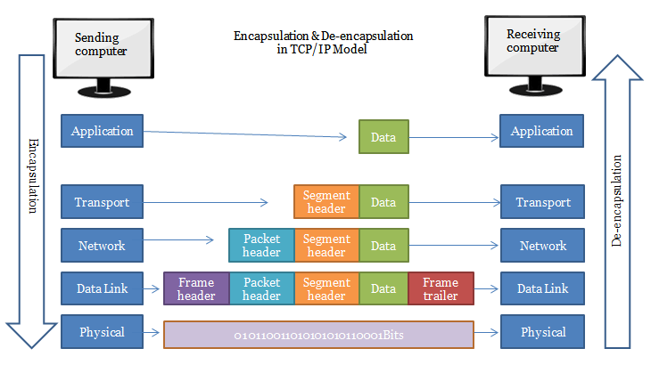
Encapsulation Further
Notes:
This process continues up and down the OSI model

Slide 6
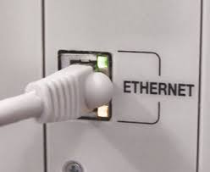
Ethernet
Ethernet was created in 1973 by a team at the Xerox Corporation's Palo Alto Research Center (Xerox PARC)
Notes:
Ethernet was created in 1973 by a team at the Xerox Corporation's Palo Alto Research Center (Xerox PARC) in California. The team, led by American electrical engineer Robert Metcalfe, sought to create a technology that could connect many computers over long distances.
It’s been more than 40 years since Bob Metcalfe published this simple diagram explaining his invention for interconnecting computers and printers at the Xerox Palo Alto Research Center in California. His patented multipoint data connection system with collision detection later became known as Ethernet.

Slide 7
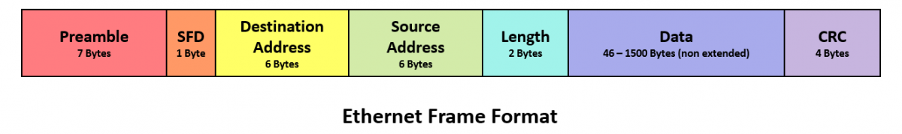
Ethernet Frames
Size: 64-1518 bytes + more with jumbo frames
Preamble
SFD
Destination and the source addresses contain the MAC address
MAC (Media Access Control) unique identification numbers
Length field
The Data field
The CRC (Cyclic Redundancy Check)
Notes:
Ethernet sends information to and from devices in frames that commonly range in size from 64 to 1518 bytes. There are also extended (or jumbo) frames for sending greater amounts of data since processing data in one frame is more efficient than having it broken up into multiple smaller frames.
Ethernet frames include a Preamble that indicates that the frame is coming and allows the sender and receiver to establish a connection. Often considered part of the Preamble, the Start of Frame Delimiter (SFD) is a one-byte field that simply indicates the start of the frame.
Two of the most important parts of the Ethernet frame are the destination and the source addresses that contain the MAC address of the device for which the data is destined and the MAC address of the device that sent the data. MAC (Media Access Control) addresses are unique identification numbers integrated into the network interface cards of every device on the network.
The Length field of the frame simply tells the receiving device how large the frame is. The Data field holds the actual data being transmitted (also sometimes referred to as Payload). The last part of the frame is the CRC (Cyclic Redundancy Check) which includes the Frame Check Sequence used to discover any corrupted data.

Slide 8
Ethernet Networking
Carrier Sense, Multiple Access with Collision Detection (CSMA/CD).
detection of the network
Traffic control
All devices receive all the frames
Retransmits if collisions occur
use a random pause
Large networks became too congested
Solution: segmentation via switches
Also full duplex
Notes:
To transmit frames from one device to another, Ethernet uses Carrier Sense, Multiple Access with Collision Detection (CSMA/CD).
In simple terms, Carrier Sense is the detection of the network and any signals being transmitted so a device knows when it’s clear to send. Multiple Access describes the fact that all devices on the network receive all the frames and check the destination address. Collision Detection is the ability for a device to recognize that it has attempted to transmit information at the same time as another device, cease transmitting and retransmit again when it’s clear to send. These retransmits use a random pause and retry to prevent devices from continuing to collide.
While Metcalfe’s first Ethernet drawing with just a few devices was quite feasible, as the number of devices trying to transmit on a single network segment increased, collisions increased, networks became congested and transmission slowed down. To reduce congestion, network segments need to be split into multiple segments that share information with each other. This is where switches come in.
Ethernet switches pick up every Ethernet transmission and forward it over the appropriate segment (i.e., link) to the destination address. This is what allows multiple devices on a network to communicate simultaneously. With Ethernet switching also came the ability to send and receive data at the same time using full-duplex Ethernet. Since devices in a modern switched network only communicate with the switch and not each other, there is no longer the need for most devices to detect collision.

Slide 9
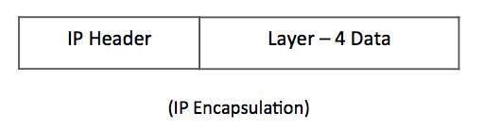
IPv4 Packet Structure
IP packets are layer 3
Divides Layer 4 (transport) segments into packets
The Data is the IP Payload
IP header tells it where to go
Notes:
Internet Protocol being a layer-3 protocol (OSI) takes data Segments from layer-4 (Transport) and divides it into packets. IP packet encapsulates data unit received from above layer and add to its own header information.
The encapsulated data is referred to as IP Payload. IP header contains all the necessary information to deliver the packet at the other end.

Slide 10
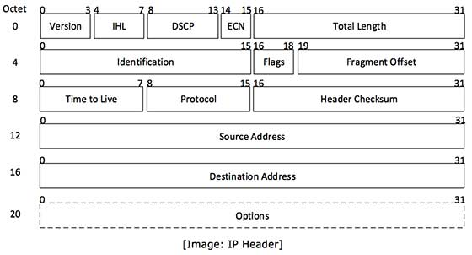
IP Header

Slide 11
IP Header
Version
IHL
DSCP
ECN .
Total Length
Identification
Flags
Fragment Offset
Time to Live
Protocol
Header Checksum
Source Address
Destination Address
Options
Notes:
IP header includes many relevant information including Version Number, which, in this context, is 4. Other details are as follows −
Version − Version no. of Internet Protocol used (e.g. IPv4).
IHL − Internet Header Length; Length of entire IP header.
DSCP − Differentiated Services Code Point; this is Type of Service.
ECN − Explicit Congestion Notification; It carries information about the congestion seen in the route.
Total Length − Length of entire IP Packet (including IP header and IP Payload).
Identification − If IP packet is fragmented during the transmission, all the fragments contain same identification number. to identify original IP packet they belong to.
Flags − As required by the network resources, if IP Packet is too large to handle, these ‘flags’ tells if they can be fragmented or not. In this 3-bit flag, the MSB is always set to ‘0’.
Fragment Offset − This offset tells the exact position of the fragment in the original IP Packet.
Time to Live − To avoid looping in the network, every packet is sent with some TTL value set, which tells the network how many routers (hops) this packet can cross. At each hop, its value is decremented by one and when the value reaches zero, the packet is discarded.
Protocol − Tells the Network layer at the destination host, to which Protocol this packet belongs to, i.e. the next level Protocol. For example protocol number of ICMP is 1, TCP is 6 and UDP is 17.
Header Checksum − This field is used to keep checksum value of entire header which is then used to check if the packet is received error-free.
Source Address − 32-bit address of the Sender (or source) of the packet.
Destination Address − 32-bit address of the Receiver (or destination) of the packet.
Options − This is optional field, which is used if the value of IHL is greater than 5. These options may contain values for options such as Security, Record Route, Time Stamp, etc.

Slide 12
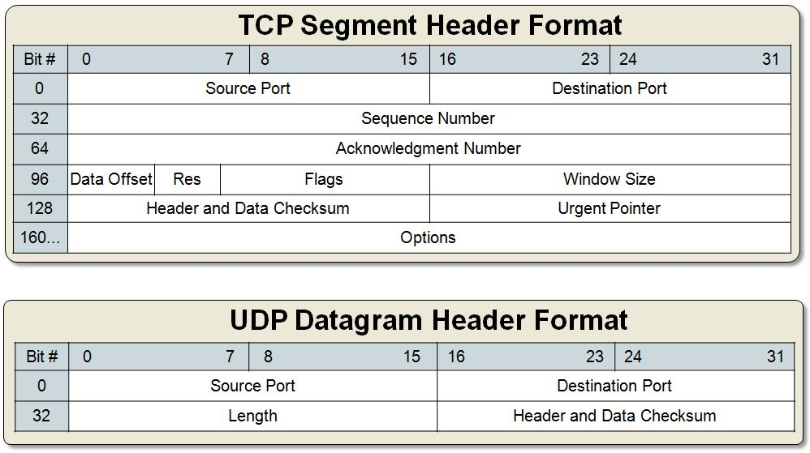
TCP and UDP
Notes:
Anyone know difference between tcp and udp

Slide 13
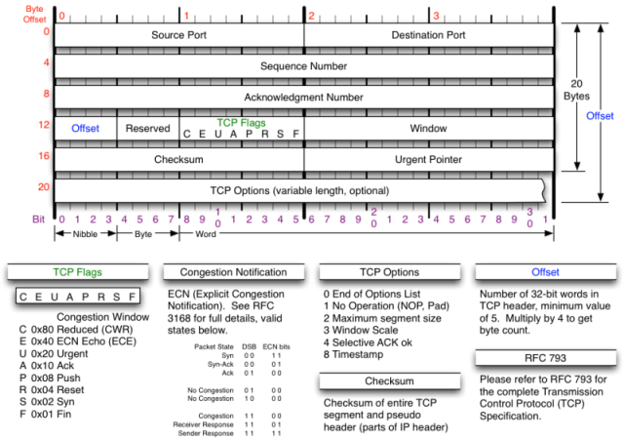
TCP Segment
Notes:
Source port: 16 Bit number which identifies the Source Port number (Sending Computer’s TCP Port).
Destination port: 16 Bit number which identifies the Destination Port number (Receiving Port).
Sequence number: 32 Bit number used for byte level numbering of TCP segments. If you are using TCP, each byte of data is assigned a sequence number. If SYN flag is set (during the initial three way handshake connection initiation), then this is the initial sequence number. The sequence number of the actual first data byte will then be this sequence number plus 1. For example, let the first byte of data by a device in a particular TCP header will have its sequence number in this field 50000. If this packet has 500 bytes of data in it, then the next packet sent by this device will have the sequence number of 50000 + 500 + 1 = 50501.
Acknowledgment Number: 32 Bit number field which indicates the next sequence number that the sending device is expecting from the other device.
Header Length: 4 Bit field which shows the number of 32 Bit words in the header. Also known as the Data Offset field. The minimum size header is 5 words (binary pattern is 0101).
Reserved: Always set to 0 (Size 6 bits).
Control Bit Flags: We have seen before that TCP is a Connection Oriented Protocol. The meaning of Connection Oriented Protocol is that, before any data can be transmitted, a reliable connection must be obtained and acknowledged. Control Bits govern the entire process of connection establishment, data transmissions and connection termination. The control bits are listed as follows: They are:
URG: Urgent Pointer.
ACK: Acknowledgement.
PSH: This flag means Push function. Using this flag, TCP allows a sending application to specify that the data must be pushed immediately. When an application requests the TCP to push data, the TCP should send the data that has accumulated without waiting to fill the segment.
RST: Reset the connection. The RST bit is used to RESET the TCP connection due to unrecoverable errors. When an RST is received in a TCP segment, the receiver must respond by immediately terminating the connection. A RESET causes both sides immediately to release the connection and all its resources. As a result, transfer of data ceases in both directions, which can result in loss of data that is in transit. A TCP RST indicates an abnormal terminination of the connection.
SYN: This flag means synchronize sequence numbers. Source is beginning a new counting sequence. In other words, the TCP segment contains the sequence number of the first sent byte (ISN).
FIN: No more data from the sender. Receiving a TCP segment with the FIN flag does not mean that transferring data in the opposite direction is not possible. Because TCP is a fully duplex connection, the FIN flag will cause the closing of connection only in one direction. To close a TCP connection gracefully, applications use the FIN flag.
Window: indicates the size of the receive window, which specifies the number of bytes beyond the sequence number in the acknowledgment field that the receiver is currently willing to receive.
Checksum: The 16-bit checksum field is used for error-checking of the header and data.
Urgent Pointer: Shows the end of the urgent data so that interrupted data streams can continue. When the URG bit is set, the data is given priority over other data streams (Size 16 bits).
In this lesson, you have learned different fields in Transmission Control Protocol (TCP) Segment Header and the use of these fields. The fields in Transmission Control Protocol (TCP) Segment Header are Source Port, Destination Port, Sequence Number, Acknowledgement Number, Header Length, Flags, Window Size, TCP Checksum and Urgent Pointer.

Slide 14
UDP Datagram
Notes:
UDP Header Datagram :
The UDP header consists of four fields each of 2 bytes in length:
Source Port (UDP packets from a client use this as a service access point (SAP) to indicate the session on the local client that originated the packet. UDP packets from a server carry the server SAP in this field)
Destination Port (UDP packets from a client use this as a service access point (SAP) to indicate the service required from the remote server. UDP packets from a server carry the client SAP in this field)
UDP length (The number of bytes comprising the combined UDP header information and payload data)
UDP Checksum (A check sum to verify that the end to end data has not been corrupted by routers or bridges in the network or by the processing in an end system. The algorithm to compute the checksum is the Standard Internet Checksum algorithm. This allows the receiver to verify that it was the intended destination of the packet, because it covers the IP addresses, port numbers and protocol number, and it verifies that the packet is not truncated or padded, because it covers the size field. Therefore, this protects an application against receiving corrupted payload data in place of, or in addition to, the data that was sent. In the cases where this check is not required, the value of 0x0000 is placed in this field, in which case the data is not checked by the receiver.
Like for other transport protocols, the UDP header and data are not processed by Intermediate Systems (IS) in the network, and are delivered to the final destination in the same form as originally transmitted. At the final destination, the UDP protocol layer receives packets from the IP network layer. These are checked using the checksum (when >0, this checks correct end-to-end operation of the network service) and all invalid PDUs are discarded. UDP does not make any provision for error reporting if the packets are not delivered. Valid data are passed to the appropriate session layer protocol identified by the source and destination port numbers (i.e. the session service access points). UDP and UDP-Lite also may be used for multicast and broadcast, allowing senders to transmit to multiple receivers.

Slide 15

Demos
https://github.comcast.com/jwierz700/networking_basics_with_scapy
Ethernet Frame
IP Packet
UDP
TCP

Slide 16
Demos tool of choice: scapy
https://scapy.net/
sendp() - layer 2
send() - layer 3.
aSPY//YASa
apyyyyCY//////////YCa |
sY//////YSpcs scpCY//Pp | Welcome to Scapy
ayp ayyyyyyySCP//Pp syY//C | Version 2.4.5
AYAsAYYYYYYYY///Ps cY//S |
pCCCCY//p cSSps y//Y | https://github.com/secdev/scapy
SPPPP///a pP///AC//Y |
A//A cyP////C | Have fun!
p///Ac sC///a |
P////YCpc A//A | Craft packets like it is your last
scccccp///pSP///p p//Y | day on earth.
sY/////////y caa S//P | -- Lao-Tze
cayCyayP//Ya pY/Ya |
sY/PsY////YCc aC//Yp
sc sccaCY//PCypaapyCP//YSs
spCPY//////YPSps
ccaacs
Notes:
Scapy is a powerful interactive packet manipulation program. It is able to forge or decode packets of a wide number of protocols, send them on the wire, capture them, match requests and replies, and much more. It can easily handle most classical tasks like scanning, tracerouting, probing, unit tests, attacks or network discovery (it can replace hping, 85% of nmap, arpspoof, arp-sk, arping, tcpdump, tethereal, p0f, etc.). It also performs very well at a lot of other specific tasks that most other tools can’t handle, like sending invalid frames, injecting your own 802.11 frames, combining technics (VLAN hopping+ARP cache poisoning, VOIP decoding on WEP encrypted channel, …), etc.
Scapy runs natively on Linux, Windows, OSX and on most Unixes with libpcap (see scapy’s installation page). The same code base now runs natively on both Python 2 and Python 3.
The send() function will send packets at layer 3. That is to say, it will handle routing and layer 2 for you. The sendp() function will work at layer 2. It’s up to you to choose the right interface and the right link layer protocol.

Slide 17

Demo Layer 2: Ethernet
Just sending some packets…
2.1_ethernet_frame.py

Slide 18
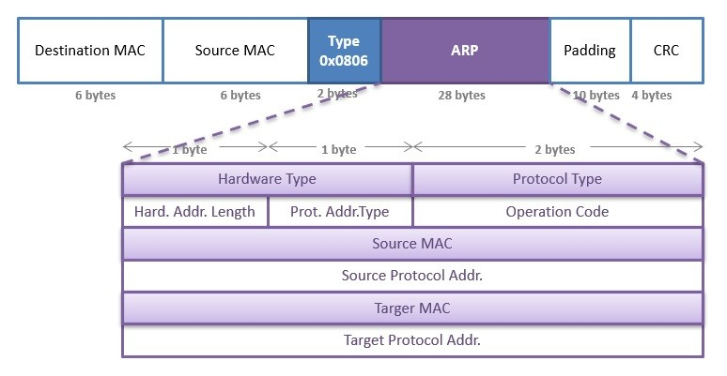
ARP
Notes:
The Address Resolution Protocol (ARP) is a communication protocol used for discovering the link layer address, such as a MAC address, associated with a given internet layer address, typically an IPv4 address.
The Address Resolution Protocol is a request-response protocol whose messages are encapsulated by a link layer protocol. It is communicated within the boundaries of a single network, never routed across internetworking nodes. This property places ARP into the link layer of the Internet protocol suite.^{[2]}
The Address Resolution Protocol uses a simple message format containing one address resolution request or response. The size of the ARP message depends on the link layer and network layer address sizes. The message header specifies the types of network in use at each layer as well as the size of addresses of each. The message header is completed with the operation code for request (1) and reply (2). The payload of the packet consists of four addresses, the hardware and protocol address of the sender and receiver hosts.

Slide 19
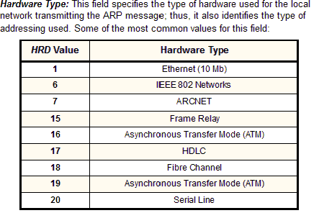
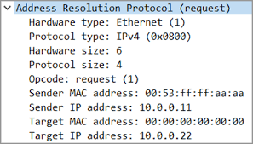
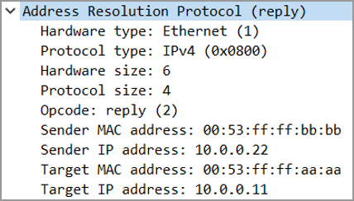
ARP
Notes:
Hardware type (HTYPE)This field specifies the network link protocol type. Example: Ethernet is 1.Protocol type (PTYPE)This field specifies the internetwork protocol for which the ARP request is intended. For IPv4, this has the value 0x0800. The permitted PTYPE values share a numbering space with those for EtherType.^{[3][4][5]}Hardware length (HLEN)Length (in octets) of a hardware address. Ethernet address length is 6.Protocol length (PLEN)Length (in octets) of internetwork addresses. The internetwork protocol is specified in PTYPE. Example: IPv4 address length is 4.OperationSpecifies the operation that the sender is performing: 1 for request, 2 for reply.Sender hardware address (SHA)Media address of the sender. In an ARP request this field is used to indicate the address of the host sending the request. In an ARP reply this field is used to indicate the address of the host that the request was looking for.Sender protocol address (SPA)Internetwork address of the sender.Target hardware address (THA)Media address of the intended receiver. In an ARP request this field is ignored. In an ARP reply this field is used to indicate the address of the host that originated the ARP request.Target protocol address (TPA)Internetwork address of the intended receiver.ARP protocol parameter values have been standardized and are maintained by the Internet Assigned Numbers Authority (IANA).^{[6]}
The EtherType for ARP is 0x0806. This appears in the Ethernet frame header when the payload is an ARP packet and is not to be confused with PTYPE, which appears within this encapsulated ARP packet.

Slide 20
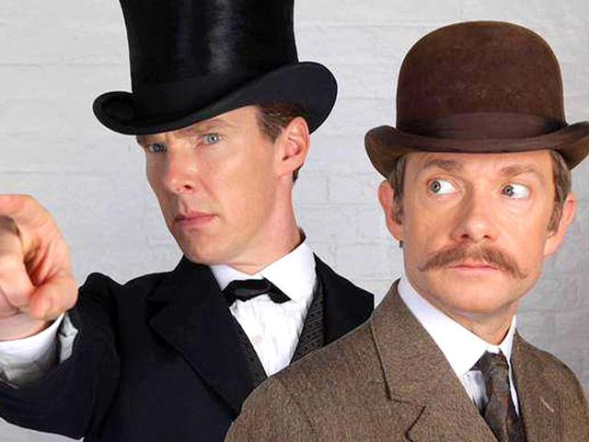
Demo Layer 2: ARP
2.2_arp.py
Arp request asking for who has 8.8.8.8
2.3_arp_resp.py
Arp request asking for who has 75.75.75.75 and response

Slide 21

Demo Layer 2: ARP
2.4_arp.py
Made up stuff

Slide 22

Demo Layer 2: ARP
2.5_arp_spoof.py
Notes:
ARP spoofing is a type of attack in which a malicious actor sends falsified ARP (Address Resolution Protocol) messages over a local area network.
The attacker chooses its target and begins sending ARP packets across the LAN that contain the attacker’s MAC address and the target’s IP address.
As other hosts on the LAN cache the spoofed ARP packets, data that those hosts send to the victim will go to the attacker instead. From here, the attacker can steal data or launch a more sophisticated follow-up attack

Slide 23
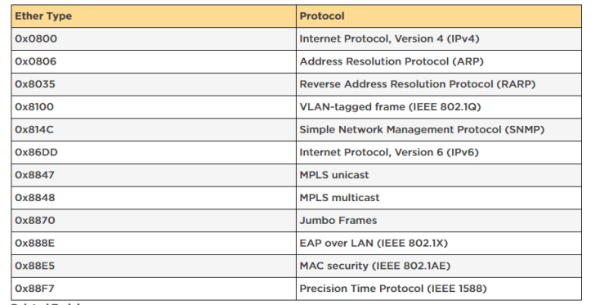
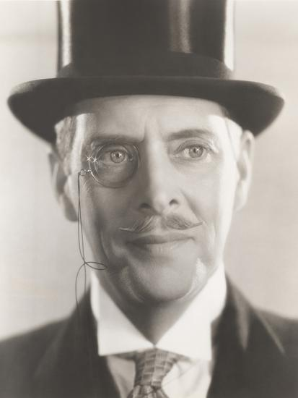
Demo Layer 2: VLAN 802.1Q
2.6_vlan.py
Notes:
IEEE 802.1Q, often referred to as Dot1q, is the networking standard that supports virtual LANs (VLANs) on an IEEE 802.3 Ethernet network. The standard defines a system of VLAN tagging for Ethernet frames and the accompanying procedures to be used by bridges and switches in handling such frames. The standard also contains provisions for a quality-of-service prioritization scheme commonly known as IEEE 802.1p and defines the Generic Attribute Registration Protocol.
Portions of the network which are VLAN-aware (i.e., IEEE 802.1Q conformant) can include VLAN tags. When a frame enters the VLAN-aware portion of the network, a tag is added to represent the VLAN membership.^{[a]} Each frame must be distinguishable as being within exactly one VLAN. A frame in the VLAN-aware portion of the network that does not contain a VLAN tag is assumed to be flowing on the native VLAN.

Slide 24

Demo Layer 3: IP
3.1_ip.py
Empty ip packet
3.2_ip2.py
Ip packet with some data

Slide 25
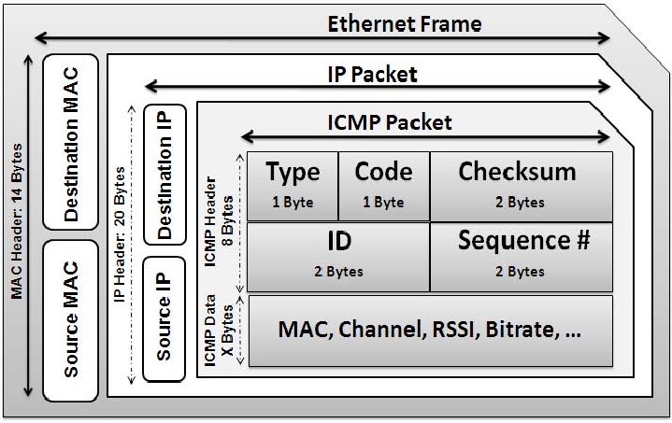
ICMP
Notes:
ICMP is part of the Internet protocol suite as defined in RFC 792. ICMP messages are typically used for diagnostic or control purposes or generated in response to errors in IP operations (as specified in RFC 1122). ICMP errors are directed to the source IP address of the originating packet.
ICMP is implemented as part of the IP layer. So ICMP processing can be viewed as occurring parallel to, or as part of, IP processing. Therefore, in the topic on TCP/IP-based layered network, ICMP is shown as a layer 3 protocol. ICMP is probably most well known as the message protocol used for the ping command.

Slide 26
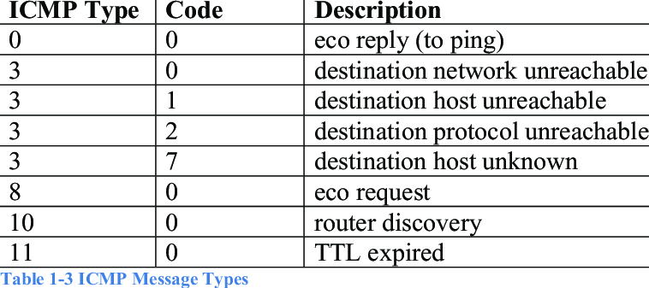
ICMP Types
Notes:
The most popular ICMP types are 8 for eco request, and 0 for eco reply (pings)

Slide 27
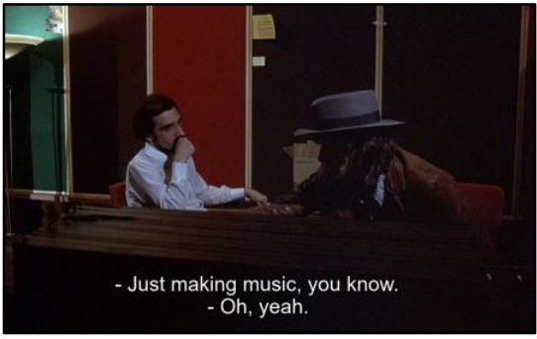
Demo 2 Layer 3: IP ICMP
3.4_ip_ICMP.py

Slide 28
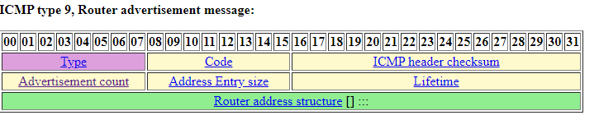
ICMP Router Advertisement
Solicitation (type 10)
Request
Advertisement (type 9)
Reply to announce their IP address
Notes:
Router Advertisement and Solicitation
The Router Solicitation and Router Advertisement messages are used as part of the Internet Router Discovery Protocol (IRDP), which is defined in RFC1256. This is a method for hosts to discover neighbouring routers without any manual configuring or DHCP support.
The Solicitation (type 10) message is sent by a host to multicast address 224.0.0.2, to request any routers on the local segment to identify themselves. Any routers that receive this message (and support IRDP) will reply with the Advertisement (type 9) message to announce their IP address as available for routing. Routers may also send the Advertisement message unsolicited on occasion (as more of an advertisement than a response).
If more than one router on the local segment responds, the host will pick the first response. If the host makes a poor choice, ICMP redirects will be used to make routing more efficient.

Slide 29
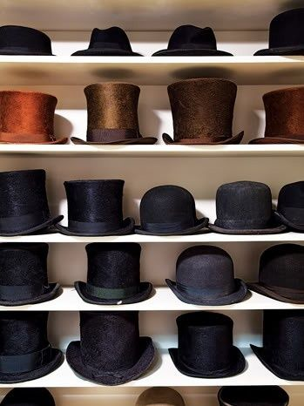
Demo 2 Layer 3: IP ICMP
3.5_ip_ICMP_router_advertisement.py
3.6_ip_ICMP_router_advertisement_custom.py

Slide 30

Looking Ahead
Layer 4 5 6 and 7

Slide 31

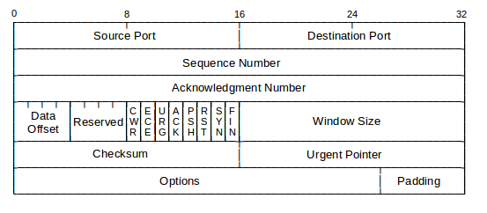
Layer 4 TCP
Notes:
As the Layer 3 IP protocol is principally a connectionless and best-efforts delivery mechanism, there is a requirement for many applications to ensure the correctly sequenced delivery of all packets within a conversation. Consequently, many applications will use Transport Control Protocol (TCP) at Layer 4 to guarantee successful delivery. TCP has several characteristics built in to ensure this delivery:
Checksum: The TCP header contains a 16-bit data checksum that is computed from all other data elements in the TCP header. The receiving end station uses this checksum to ensure that the packet arrived without corruption.
Sequence and acknowledgment numbers: Each octet of data sent and received by end stations has an associated sequence number associated with it. These sequence numbers are cumulative, whereby a certain sequence number inside the TCP header will be used to indicate that all data up to and including X should have been received. Sequence and acknowledgment numbering is used to bring the concept of order to packet delivery over IP.
Windowing: The TCP windowing technique allows two communicating end stations to build on the sequencing and acknowledgments above by removing the need for each sequence of data to be individually acknowledged. In LANs where packet loss is usually minimal, it is far more efficient to allow the sender to transmit several frames of data before an acknowledgment is sent.
Along with these mechanisms, TCP must also be able to uniquely identify each conversation within an internetwork. a TCP port number is used, among other things, to identify the application process to the high OSI layers during the conversation. Within a TCP conversation, there are in fact two port numbers used: one to identify the sender’s listening port and the other to identify the receiver’s listening port. Depending on the direction of each individual frame in the conversation, these ports become either the source port or the destination port within the Layer 4 headers. This combination of source and destination ports, along with the Layer 3 IP addressing, gives TCP the ability to uniquely identify each conversation or session within an internetwork, even in the case of the Internet itself. The Lifecycle of a TCP Session Let’s put these concepts of addresses, ports, and sequencing numbers together and look at how a conversation between two end stations is initiated, sustained, and terminated. Throughout the following example, we will assume that the client is a PC (10.10.10.10) initiating a connection to a Web server (20.20.20.20).

Slide 32
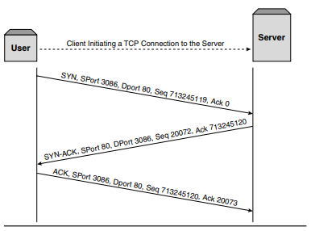

TCP three-way handshake.
Notes:
Before initiating the session, there are two pieces of information upon which the client must decide. First, in order to identify the session uniquely between itself and the server, it selects a TCP port number to represent the session. This port will be the source port for packets from the client to the server and the destination port for packets from the server to the client. The client will select the source port sequentially on a connection-by-connection basis starting from a value greater than 1024. Port numbers below 1024 are typically referred to as well-known ports and are used to identify well-known applications.
The second element that needs to be decided by the client is the starting sequence number. This will be selected based on an internal 32-bit clock that ensures both randomness and that sequence numbers will not overlap should a lost packet reappear some time after its original transmission.
Just as with the TCP ports used by both the client and server, each side also uses its own sequence numbering to identify where within the session each frame fits. Once the client has determined these two variables, it is ready to send the first packet of the session and initiate the connection to the server. Using TCP flags, the client will indicate to the server that it wants to initiate a connection by setting the SYN or synchronize flag showing that this is the first pack in the session. In TCP terms, this element is the first packet in what is commonly referred to as the “three-way handshake.” This is simply because three packets are exchanged between the client and server to bring the TCP state into that which can transport data. Consequently, no Application layer data is transmitted until at least the fourth packet in the session.

Slide 33
TCP Transferring data
TCP sequence number
TCP sequence numbers count bytes rather than packets
if there is no data, the sequence number is still set to the sequence number of the next byte that could be sent
since a TCP connection is bidirectional, a different initial sequence number (ISN) is used in each direction: each peer picks the ISN it will use in sending data
TCP acknowledgement number
the TCP ack field reports the sequence number of the next byte that is expected
this byte may have already been sent
a single packet may carry an acknowledgement but no data: this is an ack packet
Notes:
Once the connection has moved into the established state, data transmission can begin between the two end points. During this state, the ACK flag is always set and the two end stations use the sequence and acknowledgment numbering to track the successful delivery of each segment of data.
TCP sequence number
the TCP sequence number is 32 bits long
the most significant byte of the number is sent first
TCP sequence numbers count bytes rather than packets
the sequence number in the header is the sequence number of the first byte in the data
if there is no data, the sequence number is still set to the sequence number of the next byte that could be sent
since a TCP connection is bidirectional, a different initial sequence number (ISN) is used in each direction: each peer picks the ISN it will use in sending data
TCP acknowledgement number
the TCP ack field reports the sequence number of the next byte that is expected
this byte may have already been sent
a single packet may carry data and acknowledgement, and we refer to it as a data packet, or
a single packet may carry an acknowledgement but no data: this is an ack packet
the ack field must be set correctly every time the ack bit is set in the header, which is for all packets except the very first packet sent on a connection

Slide 34
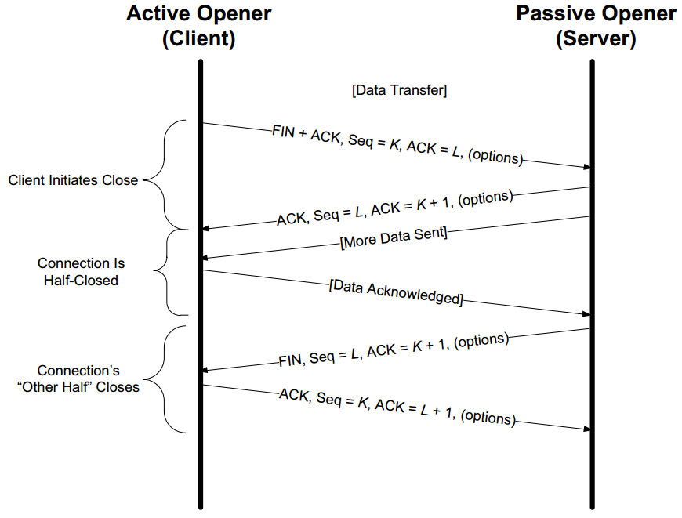
TCP Transferring data and ending transmission
Notes:
Unlike the session initiation, the termination of a TCP connection can be initiated from either side. Once one side of the connection decides that it has no more data to transmit, it will set the FIN flag in the TCP header to indicate to the other side that it is ready to terminate the connection. In simple terms, the receiving station will then acknowledge the FIN, by setting the ACK flag, and set its own FIN flag to show that it too is ready to terminate the connection. This series of exchanges results in both sides moving through the TIME WAIT state to the CLOSED state and the connection is closed

Slide 35

Feedback / QA / REFS
https://www.flukenetworks.com/blog/cabling-chronicles/101-series-ethernet-back-basics#:~:text=Ethernet%20frames%20are%20encapsulated%20within,MAC%20address%20of%20the%20device.
https://www.mouser.com/pdfdocs/Ethernet_Basics_rev2_en.pdf
https://www.tutorialspoint.com/ipv4/ipv4_packet_structure.htm
https://ptgmedia.pearsoncmg.com/images/0131014684/samplechapter/0131014684_ch02.pdf
https://skminhaj.wordpress.com/2016/02/15/tcp-segment-vs-udp-datagram-header-format/
https://linuxhint.com/http_wireshark/
https://montcs.bloomu.edu/VM-LAN/LAN04.asn.scapy.html
https://en.wikipedia.org/wiki/Address_Resolution_Protocol
https://en.wikipedia.org/wiki/EtherType
https://www.iana.org/assignments/icmp-parameters/icmp-parameters.xhtml#icmp-parameters-codes-6
http://www.networksorcery.com/enp/protocol/icmp/msg9.htm#h_Advertisement_count
https://www2.hawaii.edu/~esb/2010fall.ics451/oct04.html

